Slide 1
Max heap 101 What is inside of PriorityQueue

Slide 2
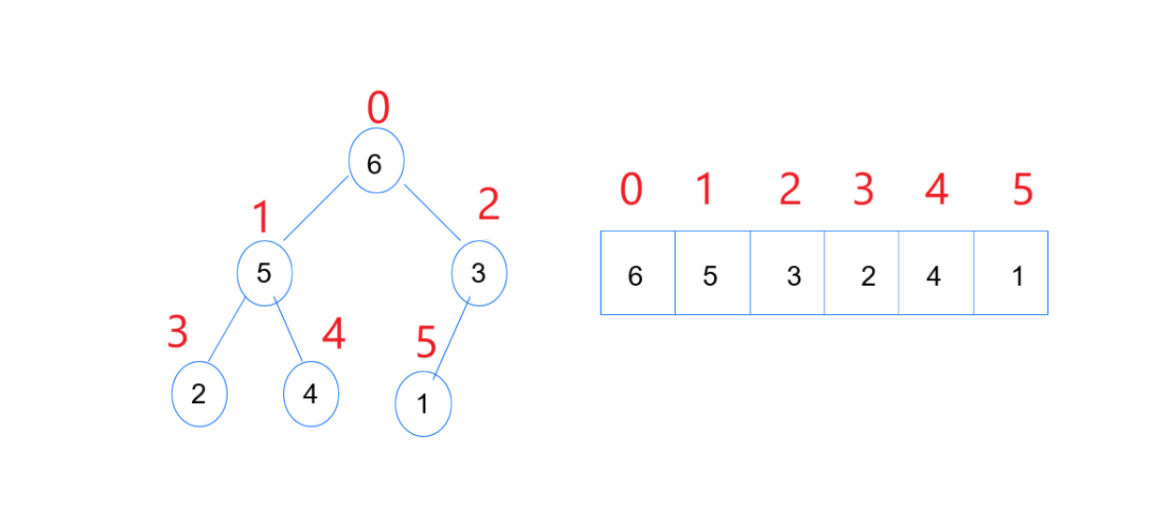
A Max-Heap is a complete binary tree where each node is greater than or equal to its children.
This ensures that the largest element is always at the root. Max-heaps are commonly used to implement priority queues.

Slide 3
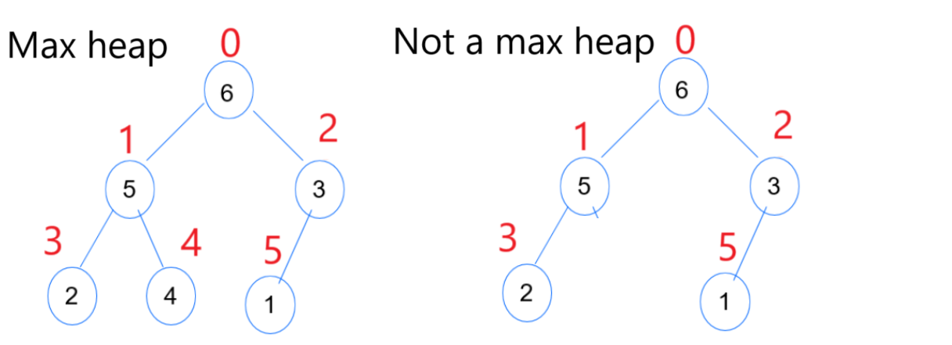
Properties of a Max-Heap:
Complete Binary Tree: All levels are fully filled except possibly the last level, which is filled from left to right.

Slide 4
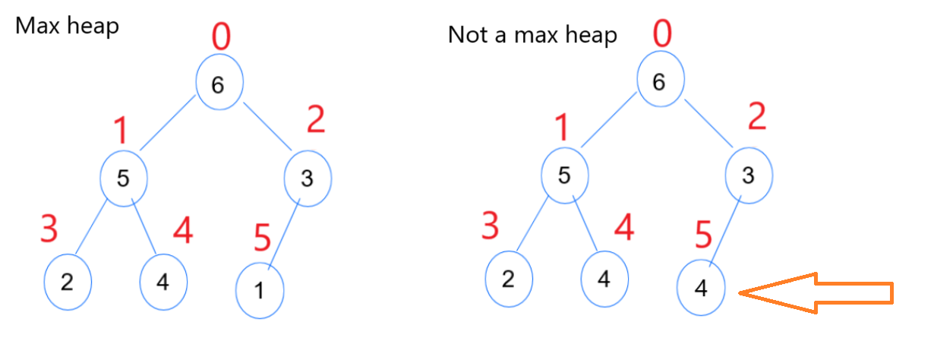
Properties of a Max-Heap:
Heap Property: For any given node i, the value of i is greater than or equal to the values of its children.

Slide 5
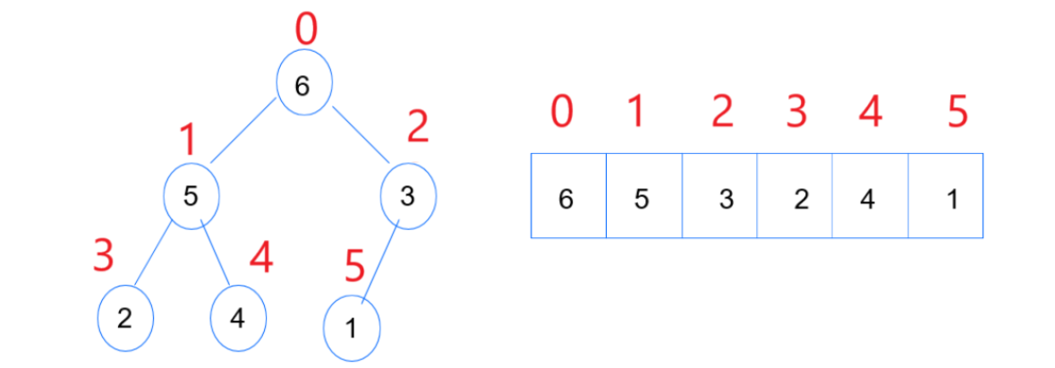
Array Representation:
Root: The root element is at index 0.
Parent: For any element at index i, the parent is at index (i - 1) / 2.
Left Child: For any element at index i, the left child is at index 2*i + 1.
Right Child: For any element at index i, the right child is at index 2*i + 2.

Slide 6
Operations on max heap
Insertion (add):
Add the new element at the end of the array.
Restore the heap property by "heapifying up".
Removal (poll):
Remove the root element (the maximum element).
Replace the root with the last element in the array.
Restore the heap property by "heapifying down".
Heapify Up:
Compare the added element with its parent.
If the added element is larger, swap it with its parent.
Repeat until the element is at the root or the parent is larger.
Heapify Down:
Compare the root element with its children.
If the root is smaller than the larger child, swap it with the larger child.
Repeat until the element is at a leaf or both children are smaller.

Slide 7
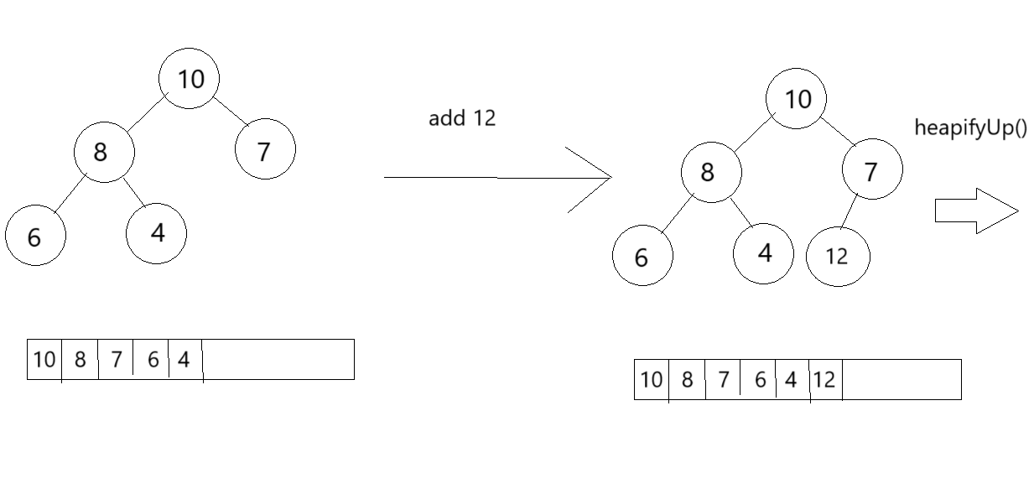
Example add()

Slide 8
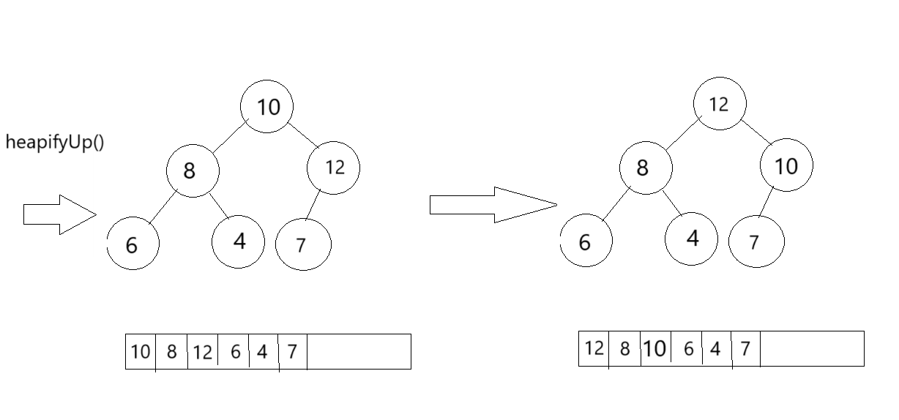
Example add() 2nd page

Slide 9
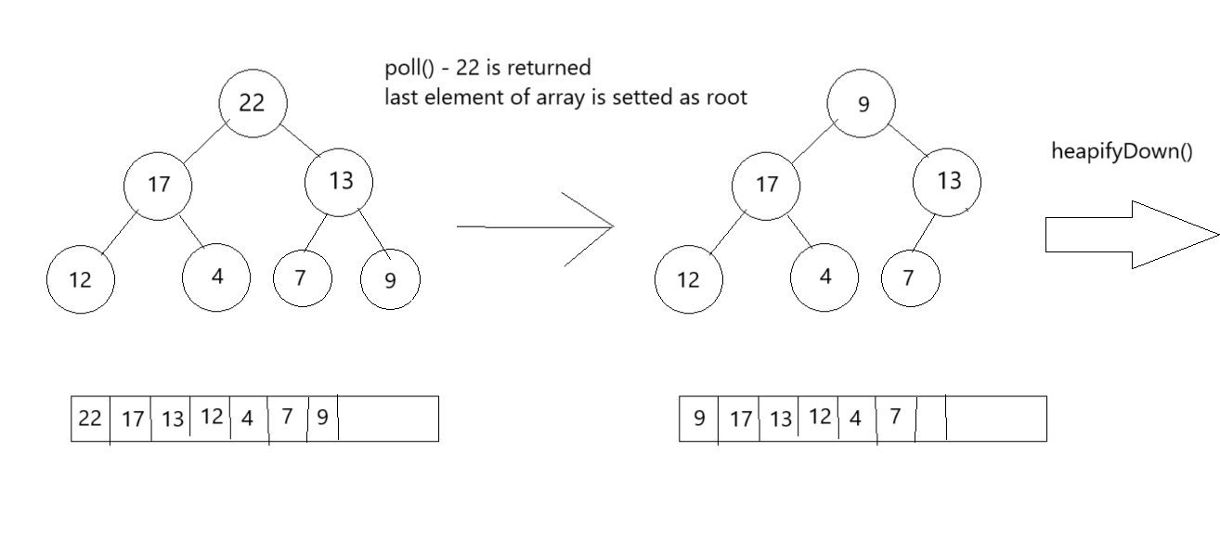
Example poll()

Slide 10
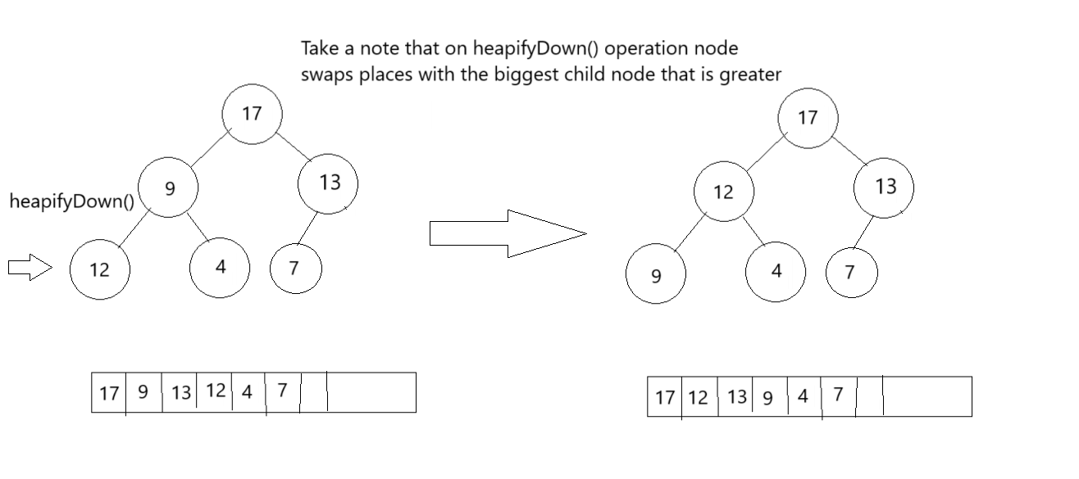
Example poll()

